Slide 1
Benchmark:
Full time horizon
Input Data
ESOM
Input Time Series
Clustering
Method
Representative Time Series
ESOM
Traditional:
Split time horizon
Features
Clustering
Method
Representative Time Series
ESOM
Based in Costs:
Split time horizon
Relaxed ESOM
(ANN + Kmedoids)
Clustering
Method
Investment Benefit
Proposal:
Split time horizon
ANN: Cost Estimator
Features
(Investment benefit)
Representative Time Series
ESOM

Slide 2
Benchmark:
Full time horizon
Input Data
ESOM
Input Time Series
Clustering
Method
Representative Time Series
ESOM
Traditional:
Split time horizon
Features
Clustering
Method
Representative Time Series
ESOM
Based in Costs:
Split time horizon
Relaxed ESOM
(ANN + Kmedoids)
Clustering
Method
Investment Benefit
Proposal:
Split time horizon
ANN: Cost Estimator
Features
(Investment benefit)
Representative Time Series
ESOM

Slide 3
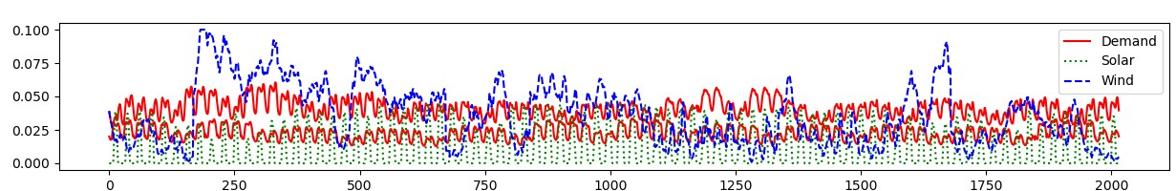
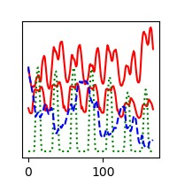
Relaxed ESOM
Relaxed ESOM
Clustering
Method
Features
Features
Clustering
Method
Representative Time Series
Representative Time Series
Representative Time Series
ESOM
ESOM
ESOM

Slide 4
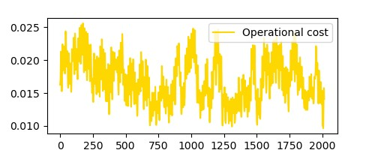
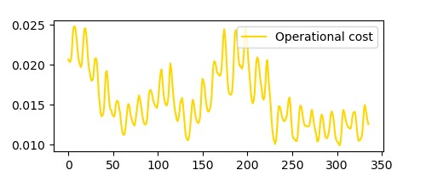
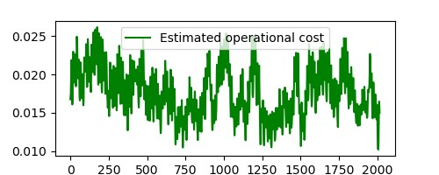
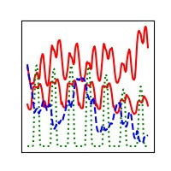
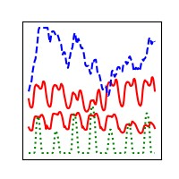
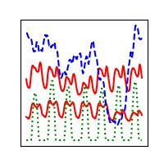
Relaxed ESOM
Relaxed ESOM
Features
Clustering
Method
Clustering
Method
Training
Evaluation
Clustering
Method
Representative Time Series
ML algorithm
NN-assisted Ex-post clustering
No temporal reduction
Input-based clustering
Ex-post clustering
ESOM
ESOM
ESOM
ESOM

Slide 5
Relaxed ESOM
Relaxed ESOM
Features
Clustering
Method
Clustering
Method
Training
Evaluation
Clustering
Method
Representative Time Series
ML algorithm
NN-assisted Ex-post clustering
No temporal reduction
Input-based clustering
Ex-post clustering
ESOM
ESOM
ESOM
ESOM

Slide 6
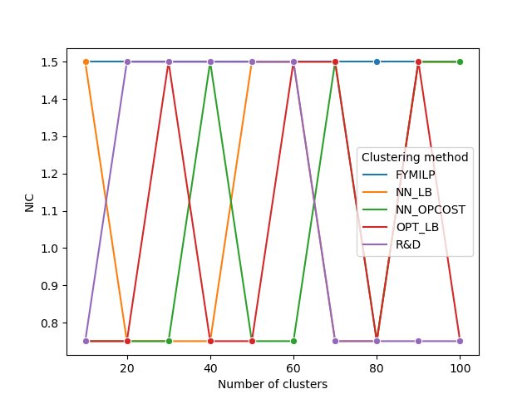
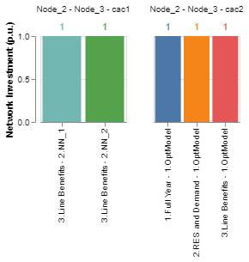
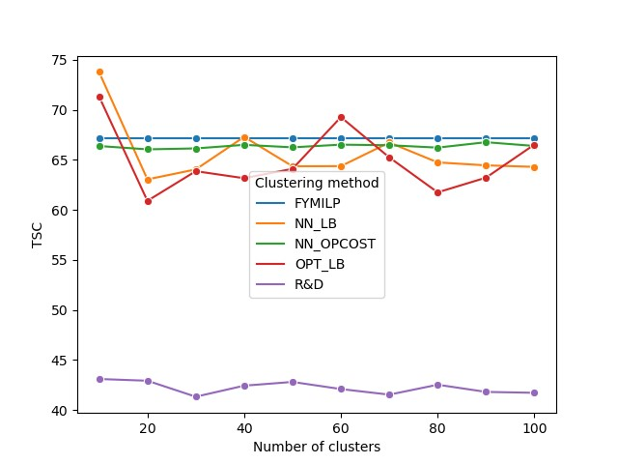
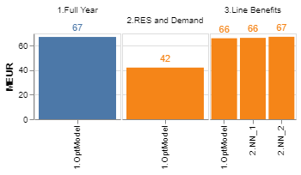
Results: 3-bus

Slide 7
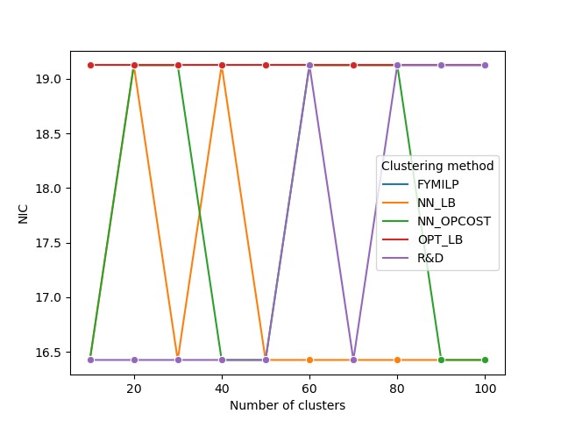
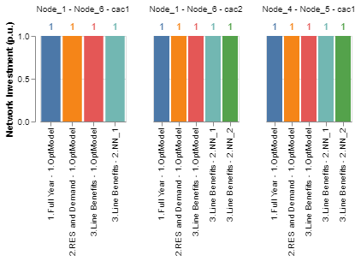
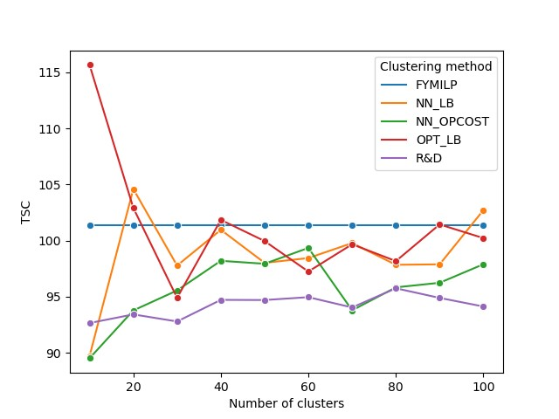
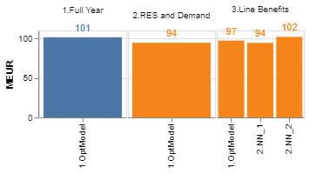
Results: 9n

Slide 8
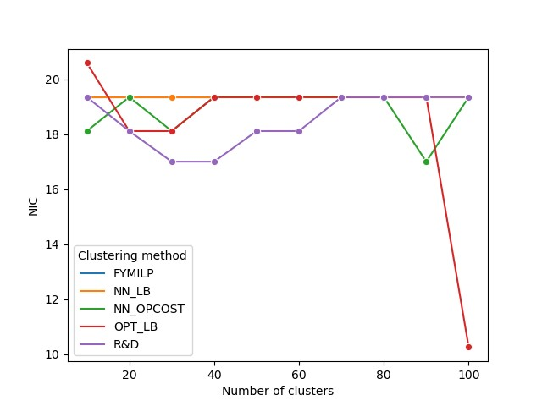
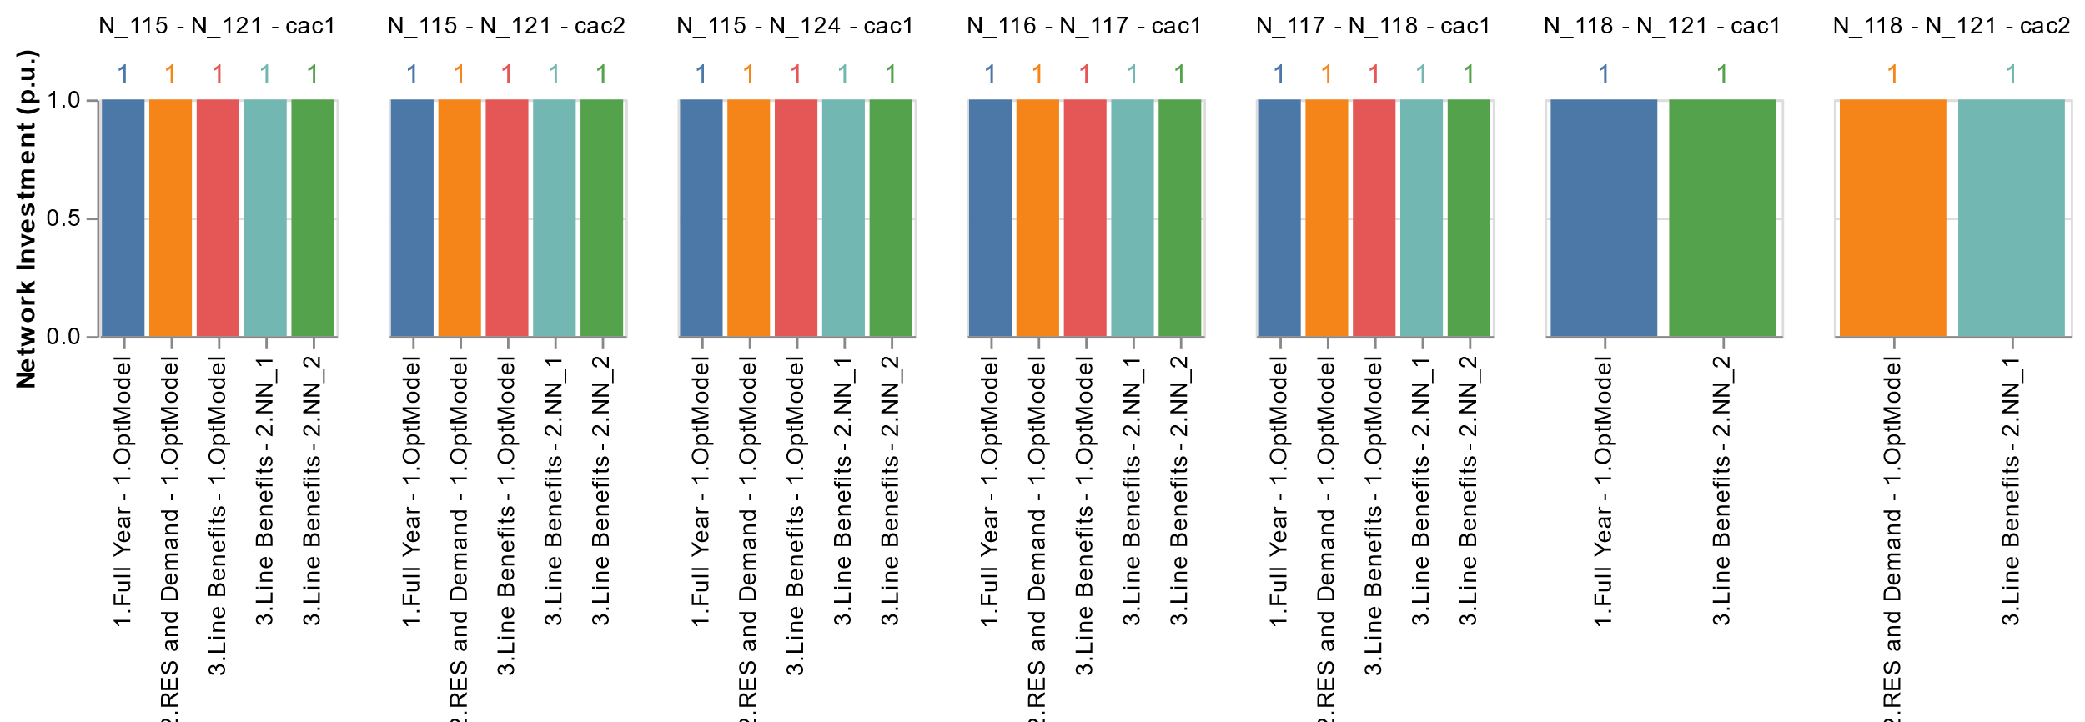
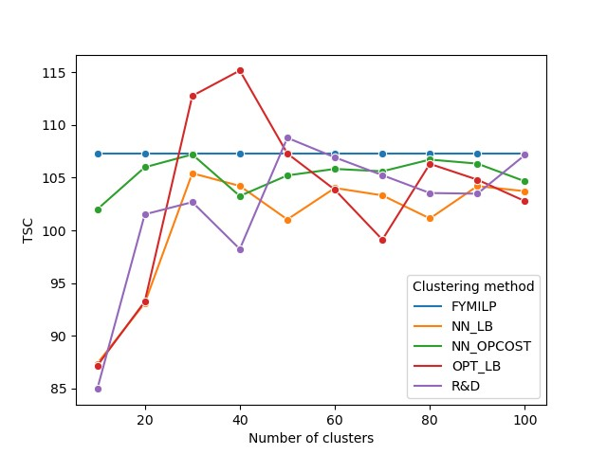
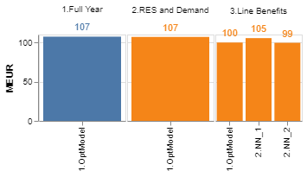
Results: RTS24

